Slide 1


The Cloud Solution Mentor Community
Guided Capability View
Maharshi Desai
Digital Engagement Platform and Industry Solution Leader
August 27, 2017

Slide 2
The Cloud Solution Mentor Community
Welcome to the Cloud Solution Mentor Community!
This online community connects newly hired solutions engineers with technical mentors to gain the right skills for accelerated learning. The new, self-service mentor community leverages the Oracle Cloud Solution website which allows members to connect, share and create various cloud focused activities. Technical mentors have an opportunity to give back - sharing expertise and experiences with new employees in an informal, virtual setting. Mentees gain access to vast resources enabling accelerated learning supporting innovative and efficient project completion. Ultimately, the Solution Engineering Mentor Community empowers the entire ecosystem of Sales Consulting to provide the right cloud solution for Oracle customers.

Slide 3
The Cloud Solution Mentor Community
Manage Your Mentorship
The mentorship within the Solution Engineering Mentor Community is defined by the parties involved. Mentees should communicate their learning objectives, while Technical Mentors should volunteer how they can best help. Together, determine you will connect and the best method for knowledge transfer and building technical skills.
Please watch quick video on how you can be Mentor or Mentee.
The Cloud Solution Mentor Community Function Demo

Slide 4
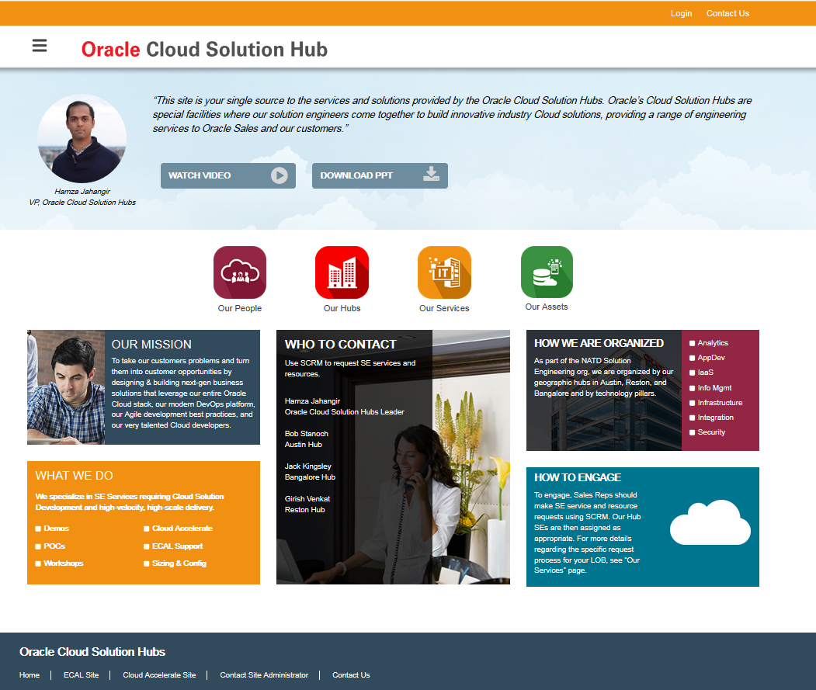
The Cloud Solution Mentor Community
Open Browser and put into private browsing mode if possible.
http://solutionengineering.us.oracle.com
Click on Login and provide your SSO credential

Slide 5
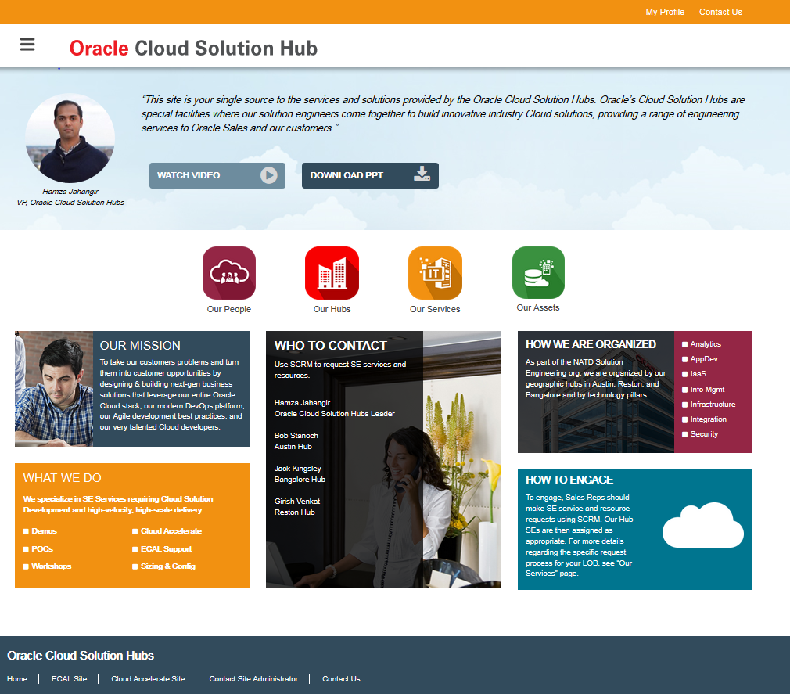
Mentor Cloud Community
Click on My Profile

Slide 6
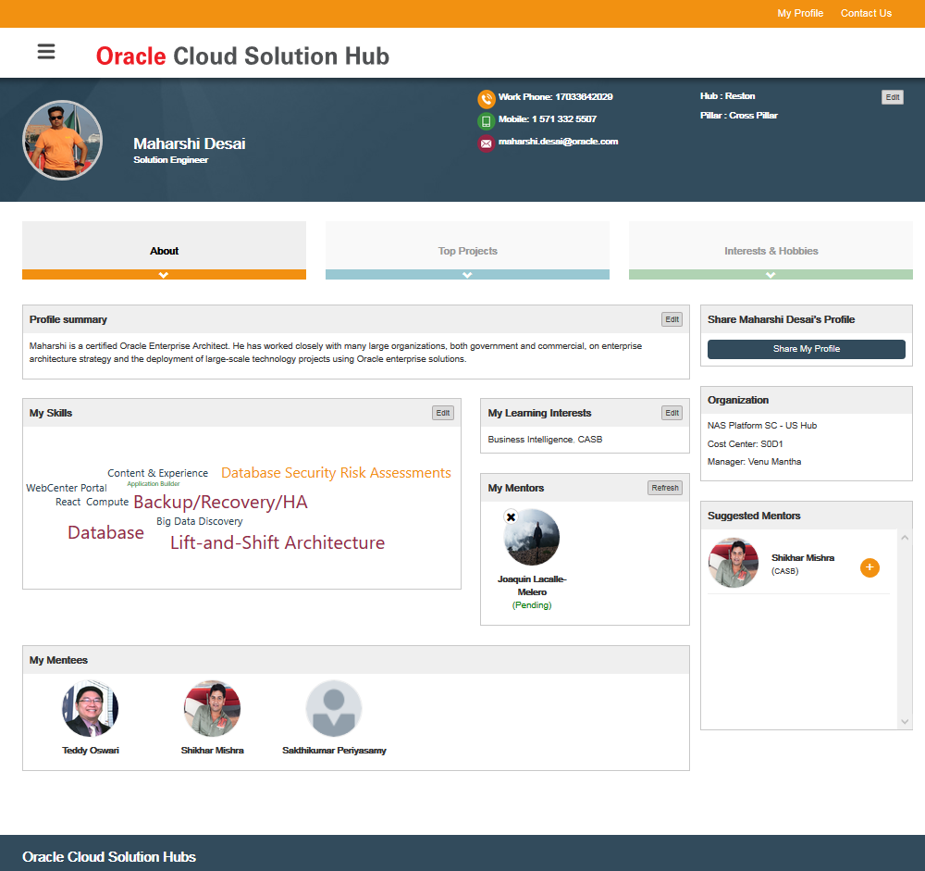
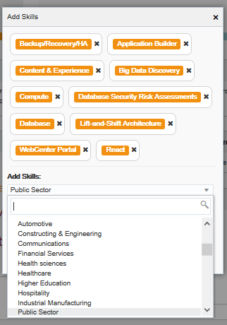
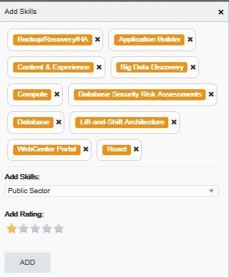
The Cloud Solution Mentor Community
Both Mentor and Mentee Need to update their skills under My Skills section
Click on Edit button as Highlighted
Add Skills from Menu
Choose your skill Rating (1-5)

Slide 7
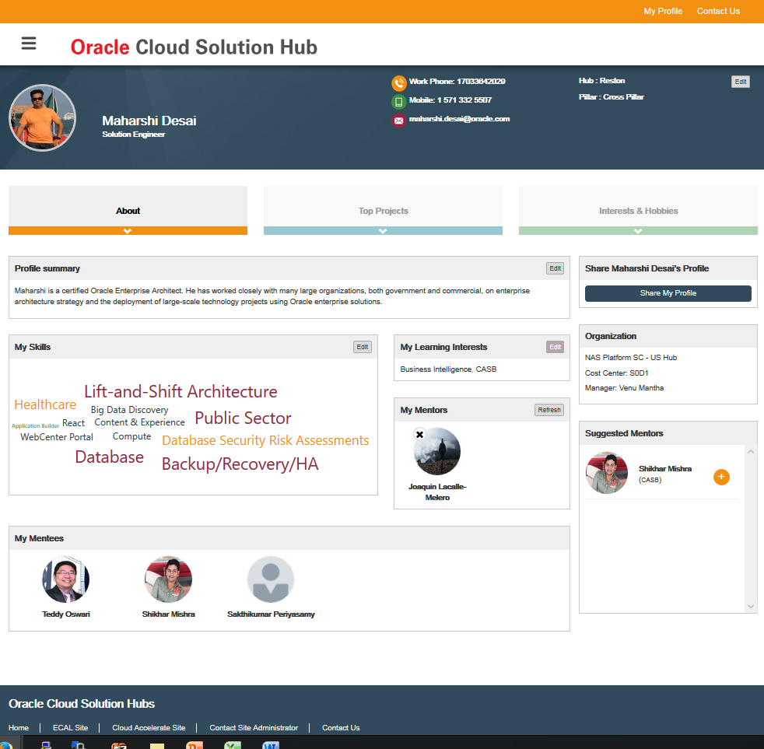
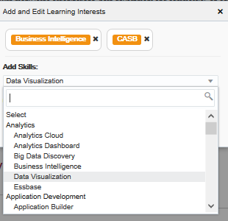
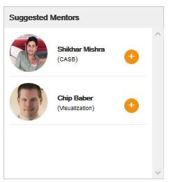
The Cloud Solution Mentor Community
If you want need Mentor then first thing is you define your learning Interest.
Click on Edit button on My Learning Interests box
Add your Learning Skills. You can add maximum 3 skills to learn.
As soon as you add your learning skills, system will recommend potential available Mentor.

Slide 8
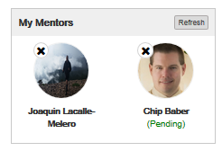
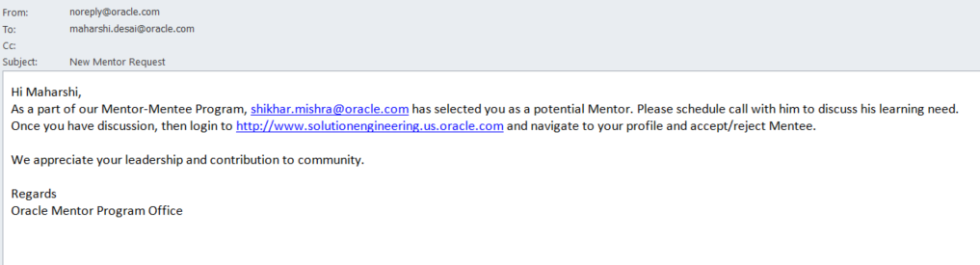
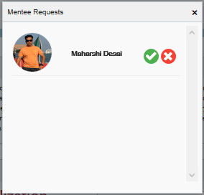
The Cloud Solution Mentor Community
Next step is view potential Mentor’s profile and add him/her.
You will notice that Mentor is added to your My Mentor box with Pending status.
System will send email to Mentor about your request.
Schedule call with your Mentor and discuss your learning need and overall Mentor fit.
Once both Mentor and Mentee agrees, Mentor will accept or reject request depending on discussion.
If accepts then Mentor will show up in without Pending status and you will also get email notifications.
If Mentor decides to reject request then he need to pick rejection reason from lists.

